Slide 1
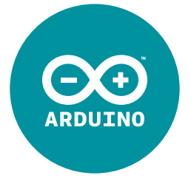
ARDUINO – Day 5
BIOE 3090

Slide 2
Project Pump

Slide 3
In-Class Design - DCW User Story to User Needs
Translate User Story into User Needs
Translate User Needs into Requirements
This can be tricky!

Slide 4
Writing Requirements
Requirements need to:
Specify a single, unique feature
Written using appropriate auxiliary verbs and language
Testable with corresponding verification test
Testable with a binary pass/fail condition
Should not include / define a solution

Slide 5
Requirements with Problems
The cost / budget shall not exceed
The bioreactor shall notify the user via LED…
The bioreactor shall have transducers that measure internal pressure.
The system shall monitor the pressure of the atmosphere within the bioreactor in MPa.
The system shall transduce a signal from the force applied to the sample by a cyclic piston.

Slide 6
In-Class
Translate User Story into User Needs
Translate User Needs into Requirements
Build Design Output matrix based on Requirements
Verification Matrix
Validation Matrix

Slide 7
Verification
Validation

Slide 8
Verification - The evaluation of whether or not a product, service, or system complies with a regulation, requirement, specification, or imposed condition. It is often an internal process.
Validation - The assurance that a product, service, or system meets the needs of the customer and other identified stakeholders. It often involves acceptance and suitability with external customers.
https://en.wikipedia.org/wiki/Verification_and_validation

